Slide 1

Online Food Ordering and Delivery System
Course: Database Systems 1
Eng: David kamal
Date: 26/10/2024

Slide 2
Project Overview
Purpose and Relevance : The online food ordering System addresses the growing demand for convenient and efficient ways to order and deliver food, meeting modern customer expectations for streamlined deigital soludtions .
Optimized Restaurant Operations: By organizing incoming orders, the system reduces errors and boosts efficiency, especially during peak times. Restaurants can better manage food preparation and workflow, improving overall service quality.
Operational Benefits: The system helps organize orders and provides real-time updates, making it easier for restaurants to work efficiently and improving the delivery process by cutting down on mistakes and wait times.
Notes:
Problems statement :
The foodservice industry has seen a growing need for digital solutions that streamline the process of ordering and delivering food, particularly with the increasing popularity of takeout and home delivery. Customers expect convenience, efficiency, and multiple options when it comes to ordering food. Traditional methods, such as calling the restaurant directly, are often inefficient, especially during peak hours, and do not provide transparency regarding delivery status or food options
Purpose of our project is to meet custormar expectation by addressing this problem using

Slide 3
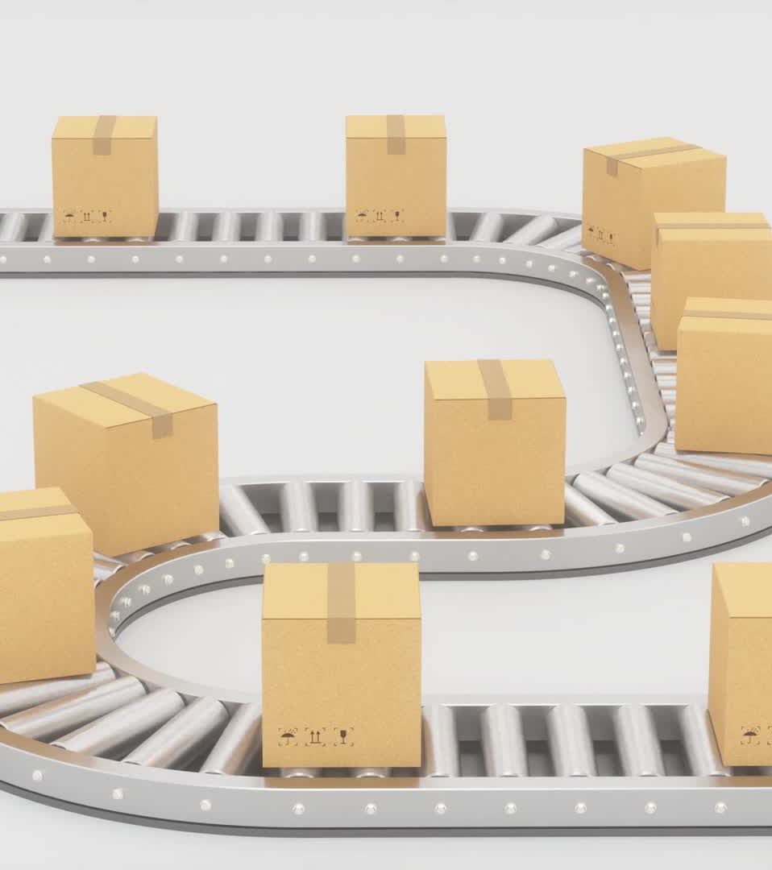
Business Needs
Enhanced Customer Experience: Convenient menu browsing, order customization, and real-time tracking for a seamless experience.
Optimized Restaurant Operations: Streamlined order management to reduce errors and improve efficiency.
Streamlined Delivery Services: Clear instructions and real-time updates for delivery agents, enhancing efficiency.
Data-Driven Insights: Valuable data collection for strategic business decisions based on customer preferences and trends.

Slide 4
Use Case Overview
Main Use Cases:
Customer Registration/Login
Restaurant Menu Browsing
Order Placement
Delivery Assignment & Tracking
Customer Feedback (Maybe futuerly added)
Flow Summary: Users interact from login to delivery.

Slide 5
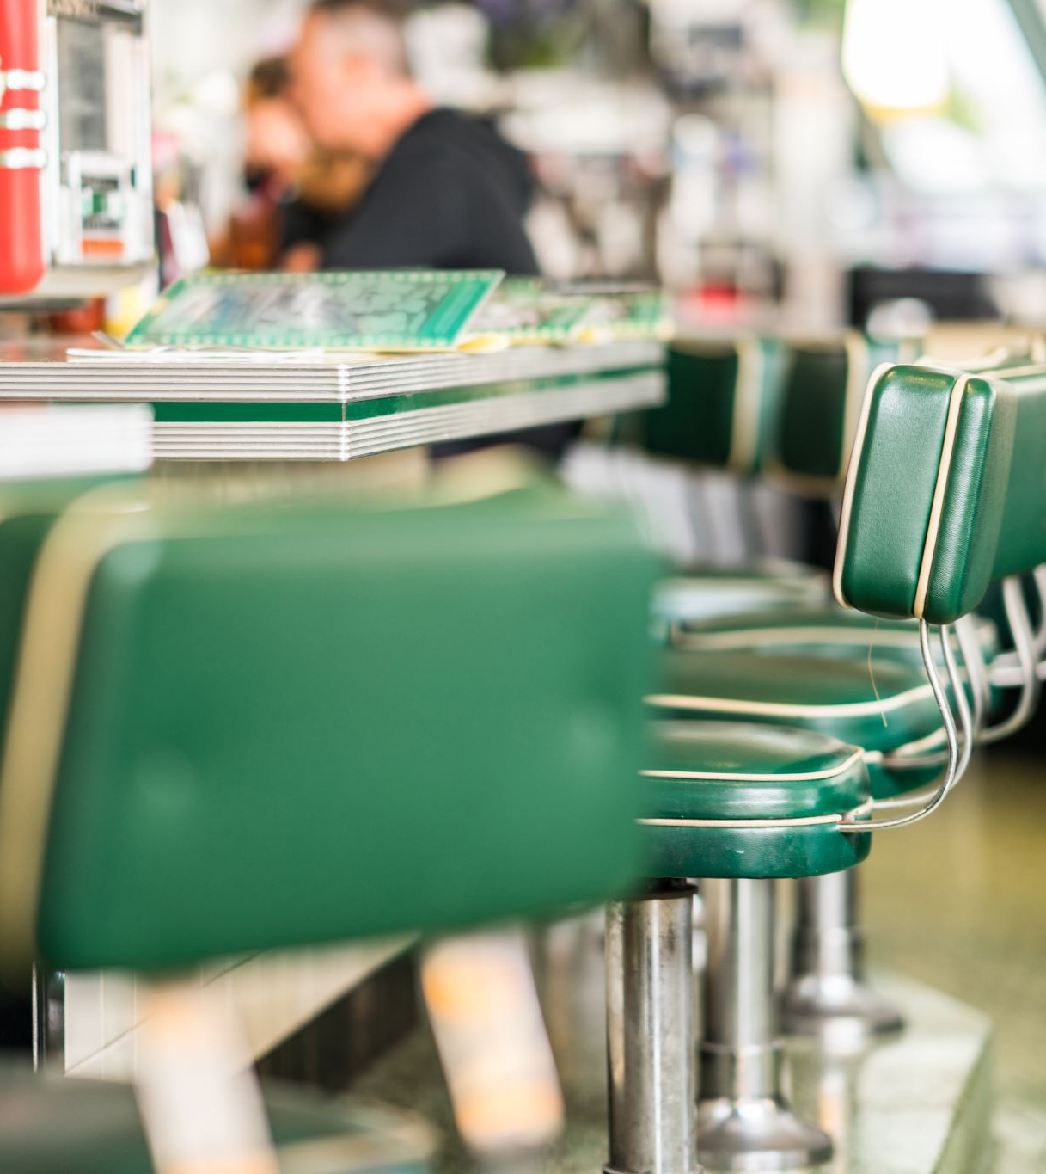
Business Case
Increased Revenue for Restaurants: Expanding reach via the online platform.
Operational Efficiency: Less manual work reduces mistakes and order handling times.
Customer Satisfaction: Real-time order tracking builds trust and improves the experience.
-Impact Summary: Customers get convenience; Restaurants get visibility; Delivery Agents get organized tasks.

Slide 6
Business Use and Data Flow
Business Use Summary: The system addresses real-world needs of customers, restaurants, and delivery agents (like a mid part between them) .
Efficiency, Convenience, and Growth: Enhances operational efficiency, customer satisfaction, and business growth.
Data Flow: From user registration, browsing restaurants, placing orders, to delivery and feedback.

Slide 7
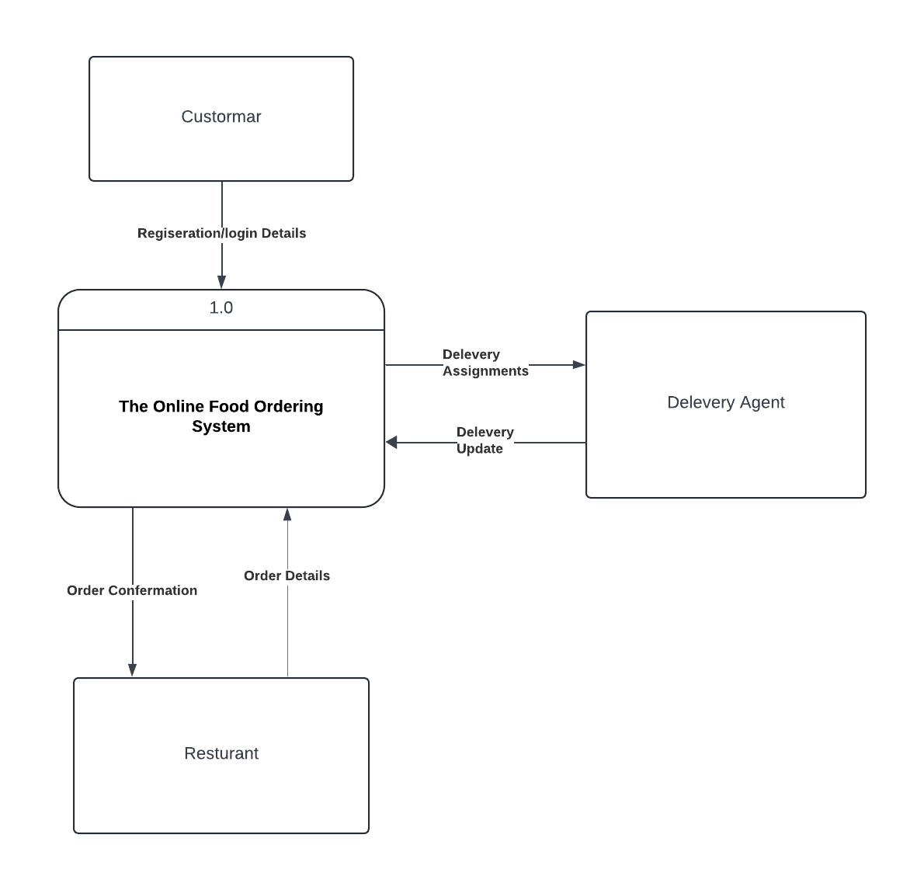
Data Flow Diagram
Level 0: Context Overview

Slide 9

Requirement Gathering Process
Functional Requirements:
Customers can place orders, track deliveries, and provide feedback.
Restaurants receive and confirm orders, manage menu items.
Non-Functional Requirements:
User-friendly system, handle concurrent orders, ensure security.
Customer Feedback Loop: Feedback collected helps improve service.

Slide 10
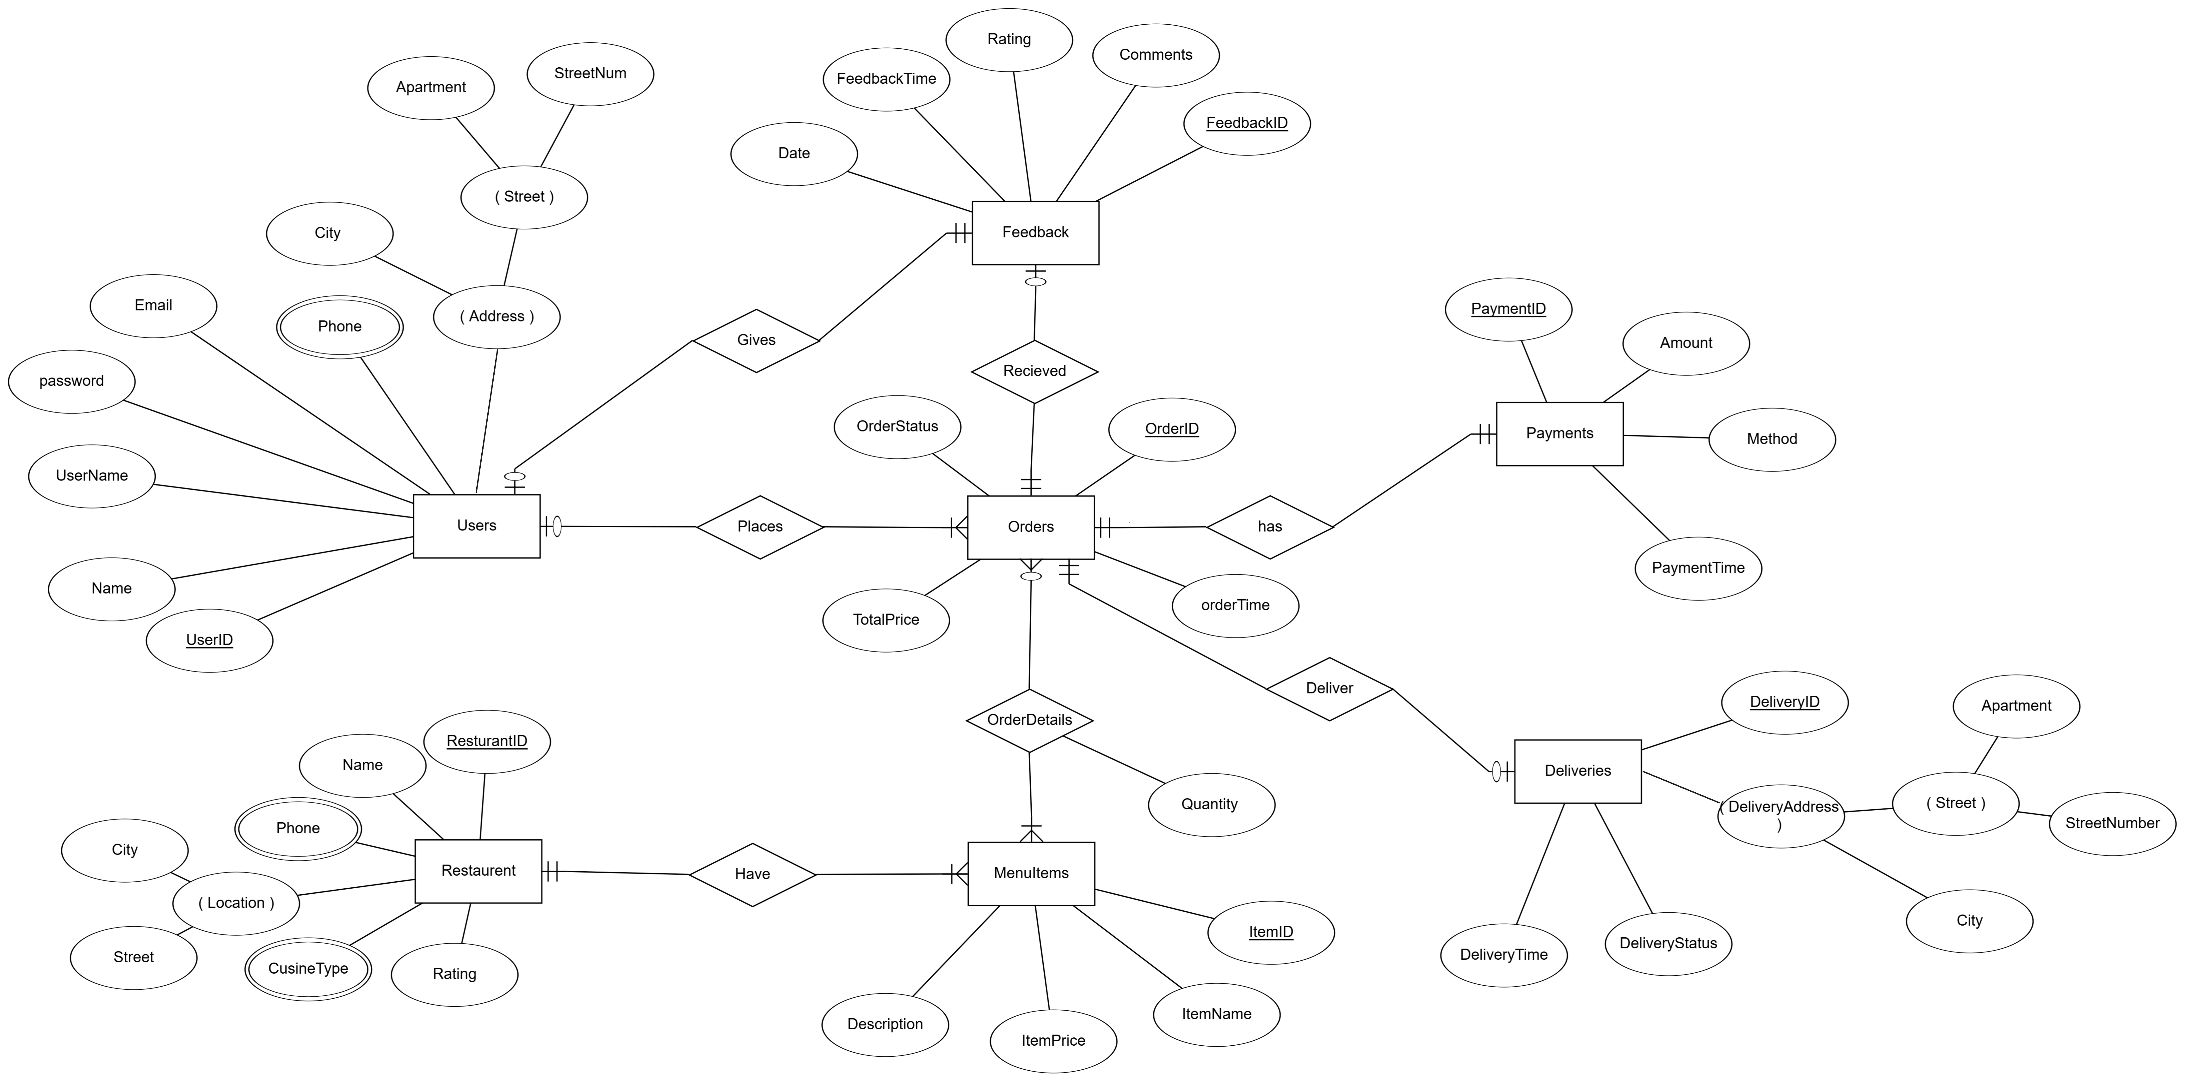
Entity-Relationship (ER) Diagram

Slide 12

Mapping

Slide 13
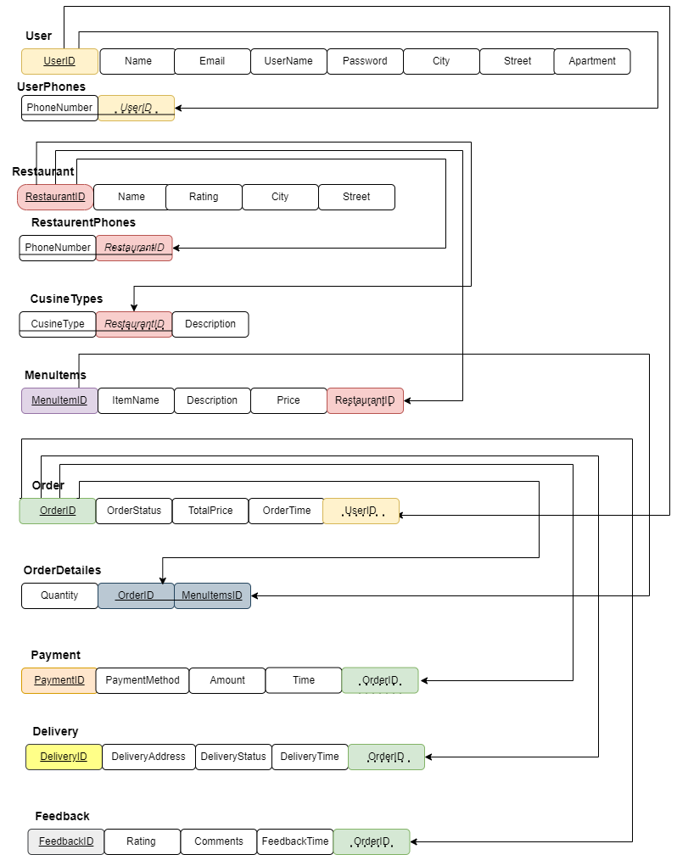

Slide 14
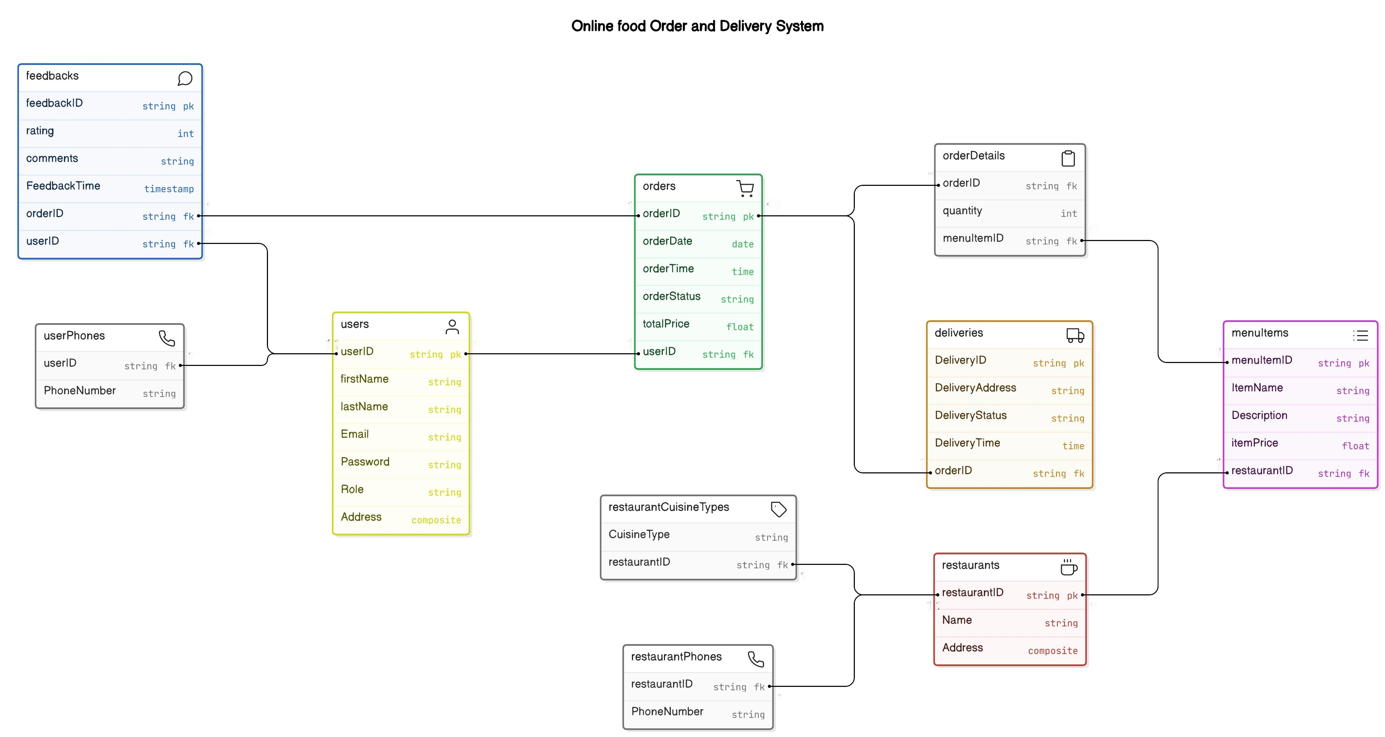
After mapping schema will look something like that
Schema

Slide 15
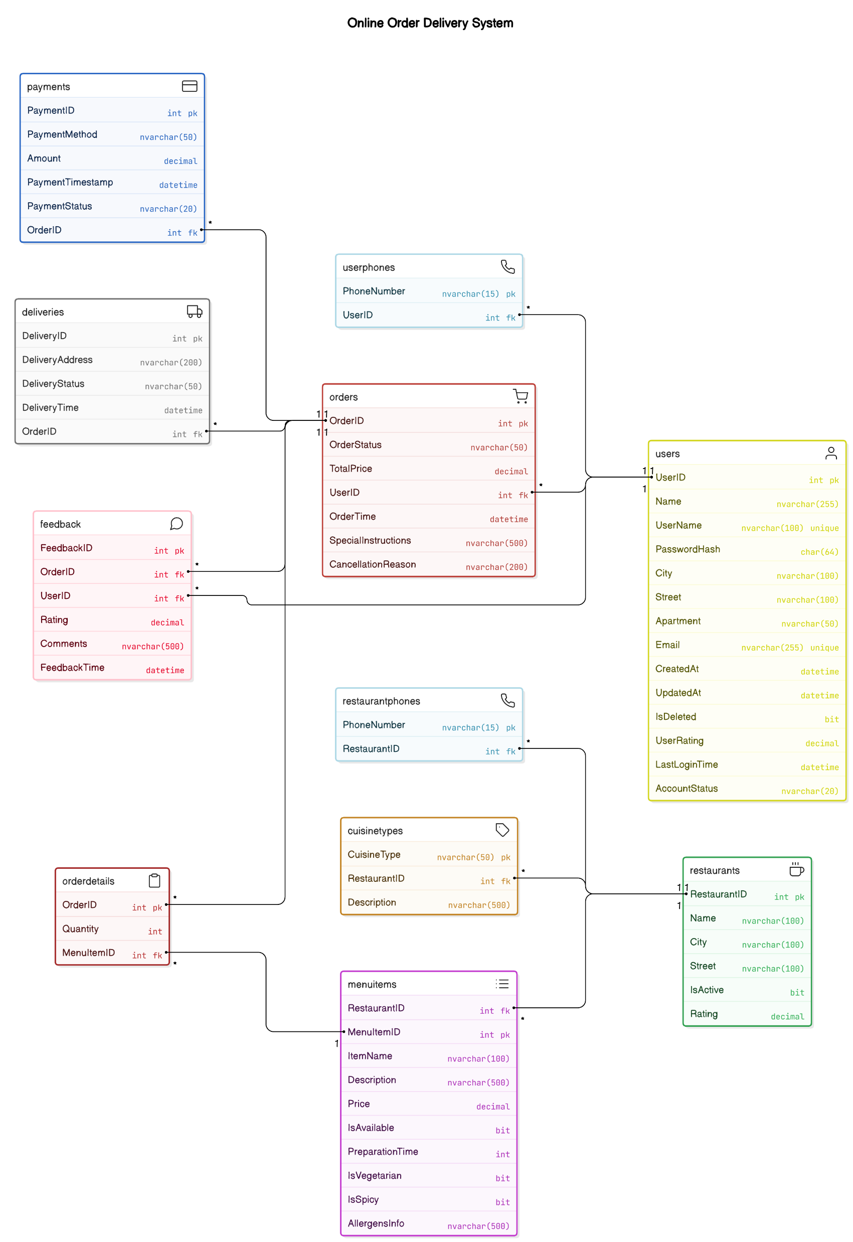

Slide 16
Key Features & Additional Highlights
Efficient Delivery Management: Delivery agents are provided with clear instructions, including pickup and drop-off details, helping them manage multiple deliveries with
Real-Time Order and Delivery Tracking: Customers receive live updates throughout the order process—from preparation to delivery—giving them clear expectations on delivery times and improving transparency.
Centralized Ordering Platform: Customers can view multiple restaurant options, filter by cuisine or dietary needs, and place orders without switching between apps or websites, offering a streamlined experience.
Data Collection for Business Insights: The system gathers and organizes customer, order, and delivery data, enabling restaurants to analyze ordering trends, popular menu items, and peak times, supporting data-driven decisions.

Slide 17
Next Step …
Begin detailed database design and schema creation.
Draft queries to manage user interactions.

Slide 18

Thank You
Team Members:
Ahmed Abdullah
Mohamed Ashraf
Ola Farhat
Salma Yasser

